Slide 1
Foundations of Data Science & Analytics DSCI 633
Lecture 10
(material sources cited in the last slide)
Nidhi Rastogi
Assistant Professor, GCCIS, RIT

Slide 2
Course Information
GitHub link - https://github.com/aiforsec/RIT-DSCI-633-FDS
Assignment 4 due at 11:59 pm on 09/30. No extensions.
Reach out to the TA/ Instructor during office hours, via Slack, or email for any questions, suggestions, concerns, or general chat about data science.

Slide 3
This Lecture
An end-to-end machine learning model pipeline
Classification, Clustering, Anomaly detection, …
Performance Measures
Error Analysis
Training Models – Linear
Linear Regression
Gradient Descent
Polynomial Regression
Regularized Linear Models
Logistic Regression

Slide 4
Lecture Agenda
K-Means Clustering
Theory: 40-45 mins
Online code practice + Questions – 15-20 mins
Pop-quiz - 10 mins

Slide 5
Clustering Models - Introduction
So far…modeled Titanic, other clean datasets extensively
Real world problems
Not that structured
No predefined labels
No where close to clean
Problem not well defined
And yet, we use them
We want to develop ML models that can classify this data correctly
HOW?

Slide 6
Clustering Models - Introduction
QUESTION: How to develop ML models that can classify unstructured, data correctly?
We find commonalities in the features that will be used to predict classes in new data.
But there is no supervision in the existing data.
we have the input features X, but we do not have the labels y
QUESTION: What is supervision?

Slide 7
Clustering Models - Introduction
Supervision comes from
Training dataset – labeled
Training dataset teaches model-> Model adjusts its weight until model has been fitted appropriately
Get categories based on the weights of the training dataset

Slide 8
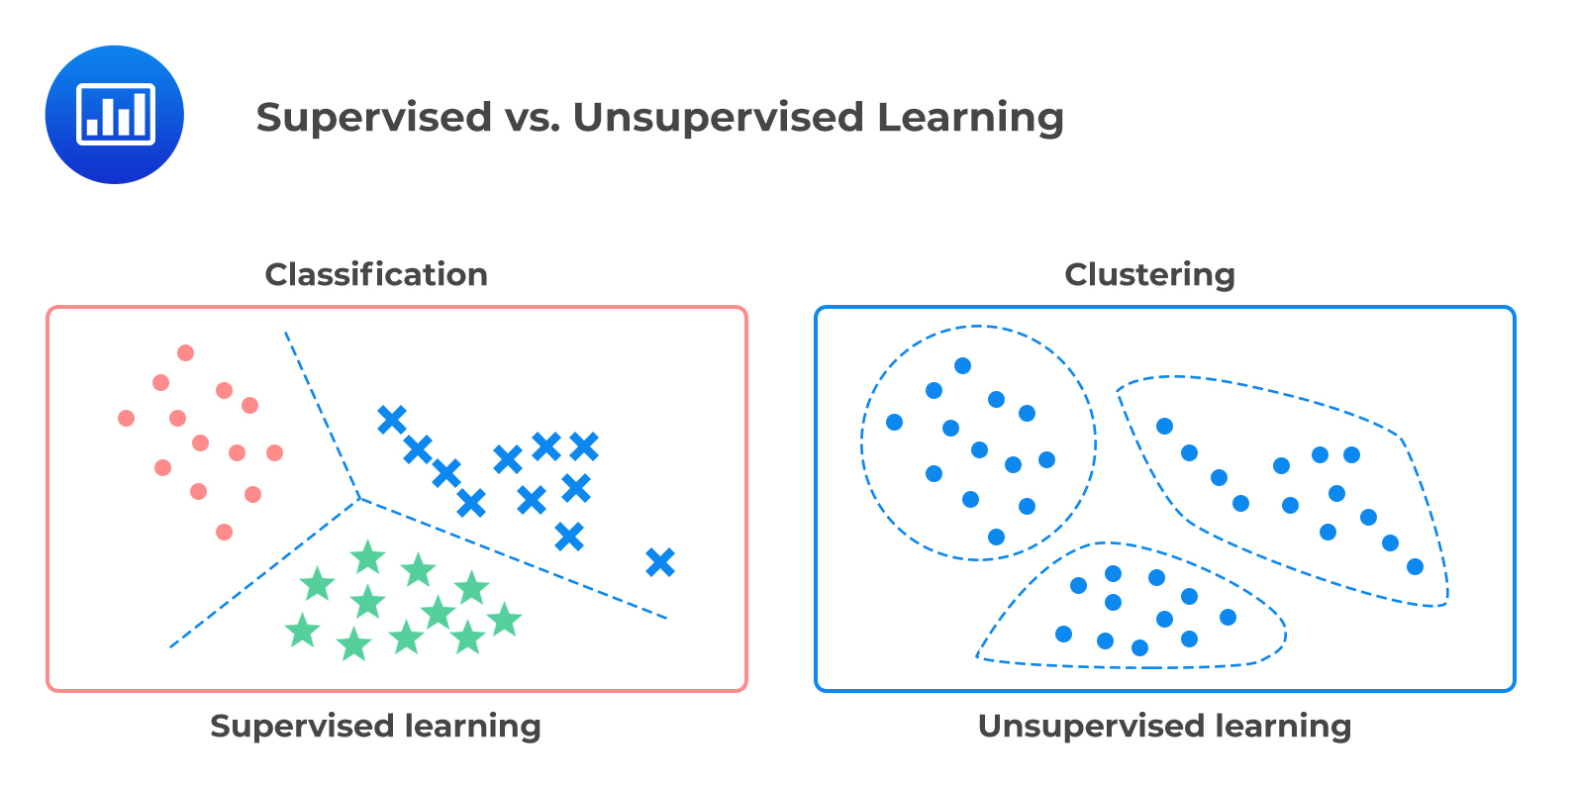
Clustering Models - Introduction

Slide 9
Clustering Models - Introduction

Slide 10
Clustering Models - Introduction
Clustering comes from
sort observations into clusters (groups)
observations within a cluster are similar
observations in different clusters are dissimilar
Goal of Clustering
Study the intrinsic (and commonly hidden)
structure of the data

Slide 11
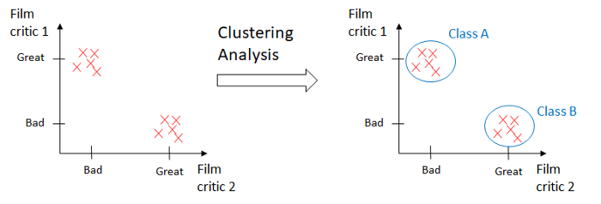
Clustering Analysis - Example
Dataset – Movies and their reviews. No labels (y).
Hypothesis
Classify movies based on reviews. EASY!

Slide 12
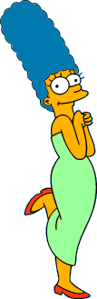








Clustering Analysis – Example Not so easy
What is a natural grouping among these images?

Slide 13
Clustering Analysis - Example
Clustering is subjective
Simpson's Family
School Employees
Females
Males

Slide 14
Clustering Analysis - Example
Clustering is subjective
Simpson's Family
School Employees
Females
Males

Slide 15
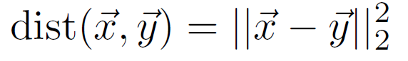
Defining Similarity
One option: Euclidean distance (squared)
Clustering results are crucially dependent on the measure of similarity (or distance) between “points” to be clustered

Slide 16
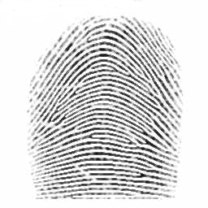
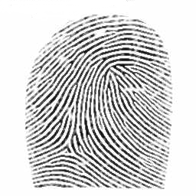
Defining Distance Metrics
Definition: Let A and B be two objects from the universe of possible objects. The distance (dissimilarity) between A and B is a real number denoted by D(A, B)
Peter
Piotr
3
0.23
342.7

Slide 17


Measuring Similarity – generic technique
Transform one of the objects into the other
Measure how much effort it took. Measure of effort becomes the distance measure.
Distance between Patty and Selma.
Change dress color, 1 point
Change earring shape, 1 point
Change hair part, 1 point
D(Patty,Selma) = 3
Distance between Marge and Selma.
Change dress color, 1 point
Add earrings, 1 point
Decrease height, 1 point
Take up smoking, 1 point
Lose weight, 1 point
D(Marge,Selma) = 5
This is called the “edit distance” or the “transformation distance”

Slide 18
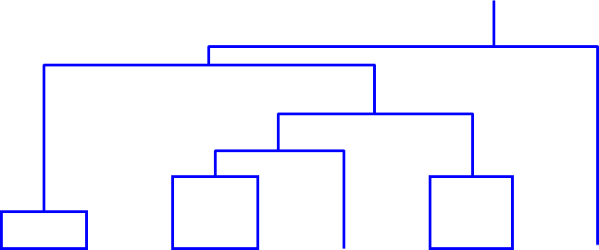
Edit Distance, example
It is possible to transform any string Q into string C, using only Substitution, Insertion and Deletion.
Assume that each of these operators has a cost associated with it.
The similarity between two strings can be defined as the cost of the cheapest transformation from Q to C.
Note that for now we have ignored the issue of how we can find this cheapest transformation
How similar are the names “Peter” and “Piotr”?
Assume the following cost function
Substitution 1 Unit
Insertion 1 Unit
Deletion 1 Unit
D(Peter,Piotr) is 3
Peter
Piter
Pioter
Piotr
Substitution (i for e)
Insertion (o)
Piotr
Pyotr
Pedro
Piero
Peter
Deletion (e)
Petros
Pietro
Pierre

Slide 19
Edit Distance, example
It is possible to transform any string Q into string C, using only Substitution, Insertion and Deletion.
Assume that each of these operators has a cost associated with it.
The similarity between two strings can be defined as the cost of the cheapest transformation from Q to C.
Note that for now we have ignored the issue of how we can find this cheapest transformation
How similar are the names “Peter” and “Piotr”?
Assume the following cost function
Substitution 1 Unit
Insertion 1 Unit
Deletion 1 Unit
D(Peter,Piotr) is 3
Peter
Piter
Pioter
Piotr
Substitution (i for e)
Insertion (o)
Deletion (e)

Slide 20
Properties of Distance Measure
D( , )
D(A,B) = D(B,A) Symmetry
Otherwise you could claim “Alex looks like Bob, but Bob looks nothing like Alex.”
D(A,A) = 0 Constancy of Self-Similarity
Otherwise you could claim “Alex looks more like Bob, than Bob does.”
D(A,B) = 0 Iff A=B Positivity (Separation)
Otherwise there are objects in your world that are different, but you cannot tell apart.
D(A,B) ≤ D(A,C) + D(B,C) Triangular Inequality
Otherwise you could claim “Alex is very like Bob, and Alex is very like Carl, but Bob is very unlike Carl.”

Slide 21
Applications of Clustering
Customer Segmentation: based on purchases, activity on website. Can help understand needs of customer, cluster them based on their needs. Adapt products and marketing campaigns to each cluster (called segment).
Build a recommender systems - Suggest content user in same cluster enjoy
Data analysis: when analyzing a new dataset, often useful to first discover clusters of similar instances, as it is often easier to analyze clusters separately.
For anomaly detection: Any instance with large distance from all clusters is likely to be an anomaly.
Example: detect users with unusual behavior, such as an unusual number of requests per second
Useful in detecting defects in manufacturing, or for fraud detection.

Slide 22
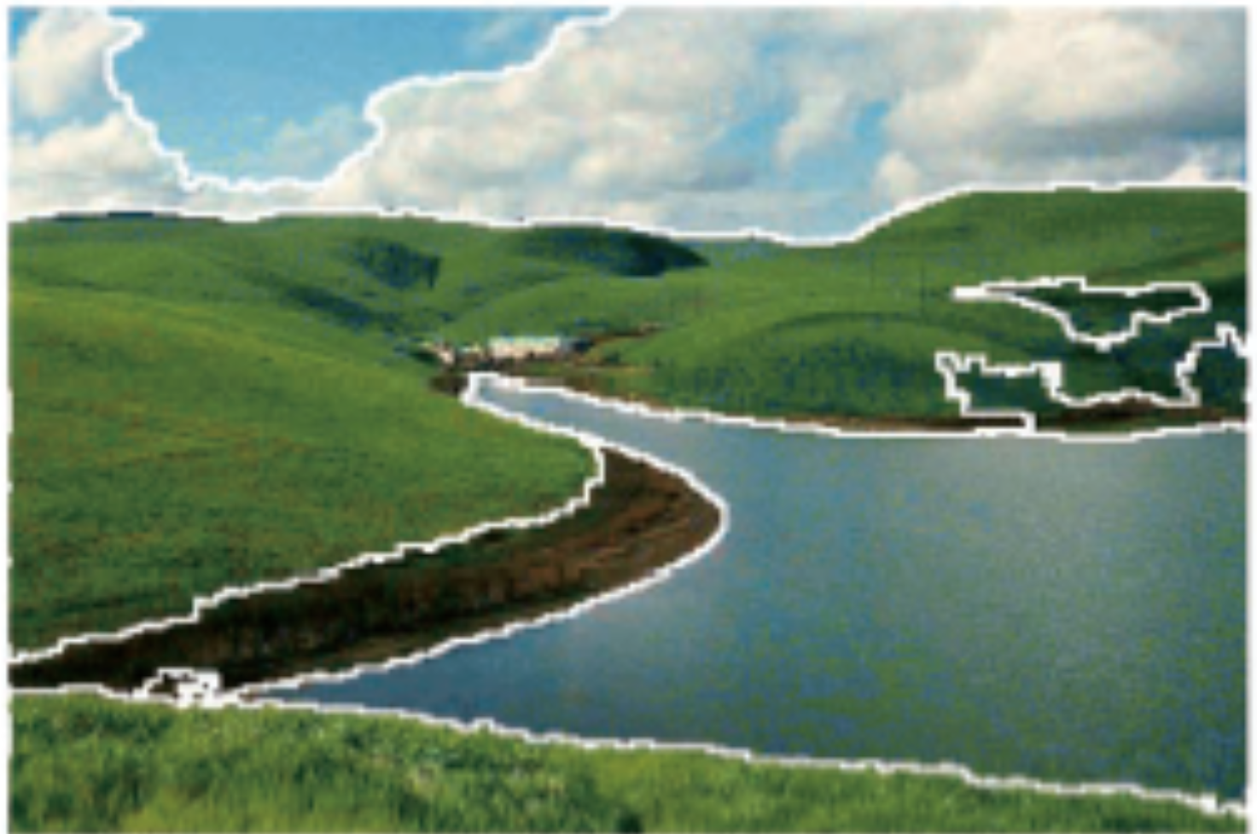
Applications of Clustering
For search engines: Search for images similar to reference image.
How?
To segment an image
Clustering pixels according to their color
Replacing each pixel’s color with mean color of its cluster
Technique used in many object detection and tracking systems, as it makes it easier to detect the contour of each object.

Slide 23
Clustering Algorithms
Partitional Algorithms (Flat)
Construct various partitions and then evaluate them by some criterion
Hierarchical Algorithms
Create a hierarchical decomposition of the set of objects using some criterion

Slide 24
Clustering Algorithms
Partitional Algorithms (Flat)
K-means
Mixture of Gaussian
Spectral Clustering
Hierarchical Algorithms
Bottom up – agglomerative
Top down - divisive

Slide 25
K-Means Clustering

Slide 26
K-Means
A type of Partitional Clustering
Nonhierarchical, each instance is placed in exactly one of K nonoverlapping clusters.
Since only one set of clusters is output, the user normally has to input the desired number of clusters K.

Slide 27
K-Means
An iterative clustering algorithm:
Decide on a value for k.
Initialize the k cluster centers (randomly, if necessary).
Decide the class memberships of the N objects by assigning them to the nearest cluster center.
Re-estimate the k cluster centers, by assuming the memberships found above are correct.
If none of the N objects changed membership in the last iteration, exit. Otherwise goto 3.

Slide 28
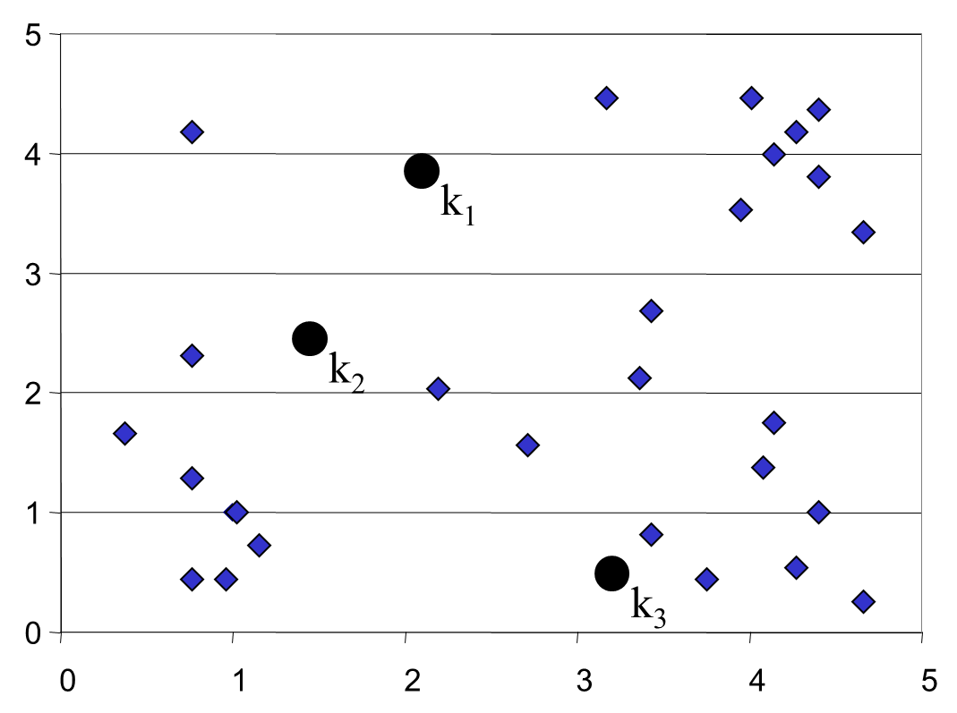
K-Means
An iterative clustering algorithm:
Decide on a value for k.
Initialize the k cluster centers (randomly, if necessary).
Decide the class memberships of the N objects by assigning them to the nearest cluster center.
Re-estimate the k cluster centers, by assuming the memberships found above are correct.
If none of the N objects changed membership in the last iteration, exit. Otherwise goto 3.
Algorithm: k-means, Distance Metric: Euclidean Distance

Slide 29
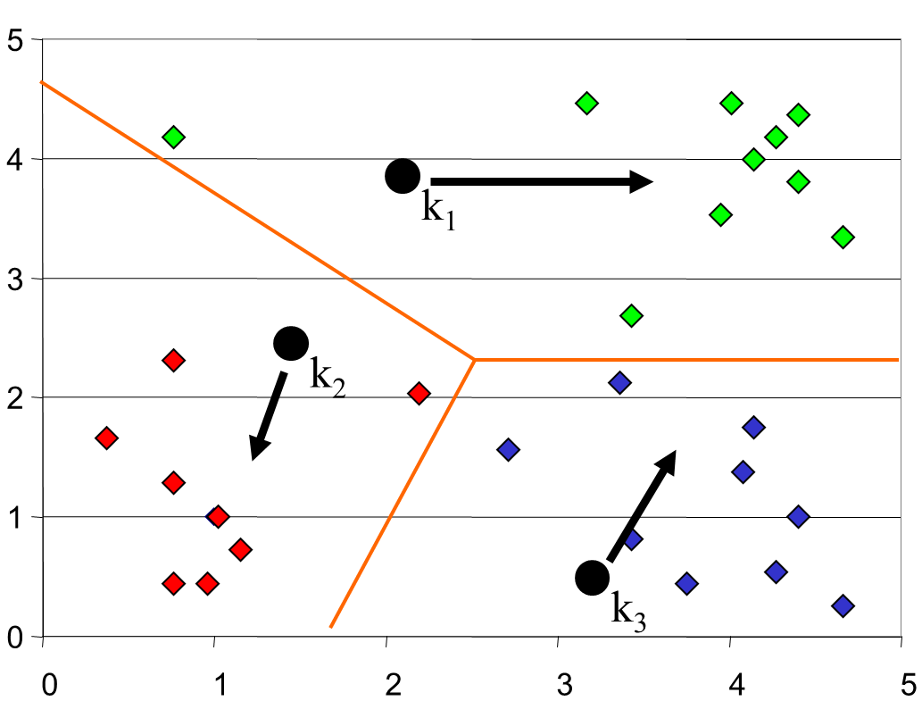
K-Means
An iterative clustering algorithm:
Decide on a value for k.
Initialize the k cluster centers (randomly, if necessary).
Decide the class memberships of the N objects by assigning them to the nearest cluster center.
Re-estimate the k cluster centers, by assuming the memberships found above are correct.
If none of the N objects changed membership in the last iteration, exit. Otherwise goto 3.
Algorithm: k-means, Distance Metric: Euclidean Distance

Slide 30
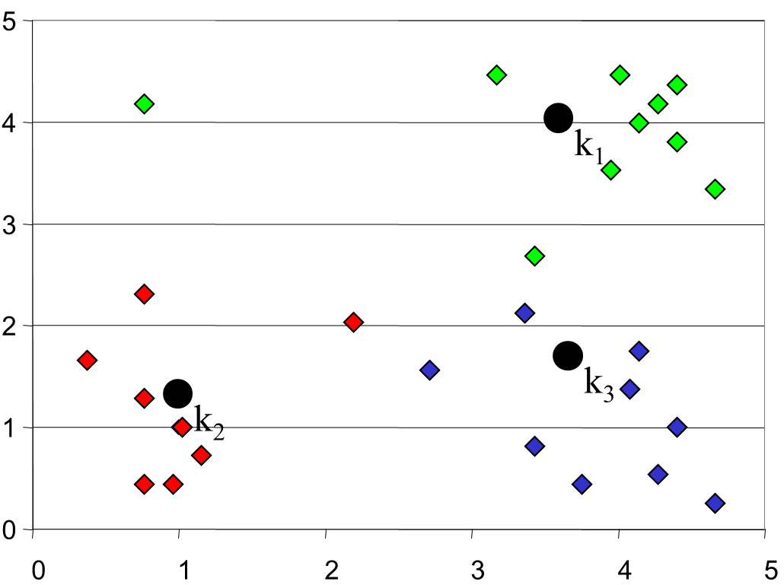
K-Means
An iterative clustering algorithm:
Decide on a value for k.
Initialize the k cluster centers (randomly, if necessary).
Decide the class memberships of the N objects by assigning them to the nearest cluster center.
Re-estimate the k cluster centers, by assuming the memberships found above are correct.
If none of the N objects changed membership in the last iteration, exit. Otherwise goto 3.
Algorithm: k-means, Distance Metric: Euclidean Distance

Slide 31
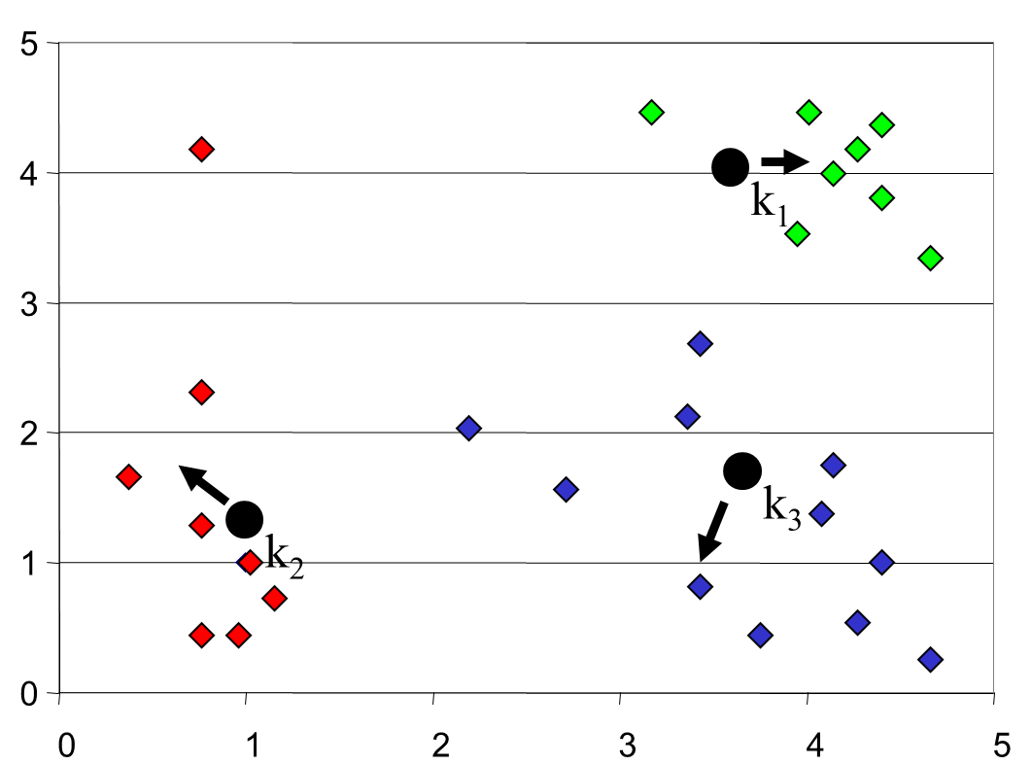
K-Means
An iterative clustering algorithm:
Decide on a value for k.
Initialize the k cluster centers (randomly, if necessary).
Decide the class memberships of the N objects by assigning them to the nearest cluster center.
Re-estimate the k cluster centers, by assuming the memberships found above are correct.
If none of the N objects changed membership in the last iteration, exit. Otherwise goto 3.
Algorithm: k-means, Distance Metric: Euclidean Distance

Slide 32
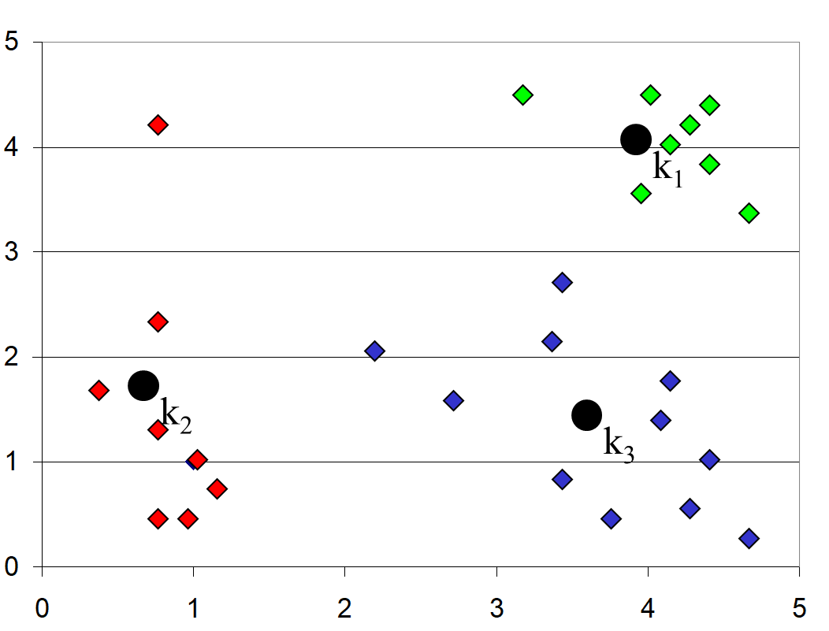
K-Means
An iterative clustering algorithm:
Decide on a value for k.
Initialize the k cluster centers (randomly, if necessary).
Decide the class memberships of the N objects by assigning them to the nearest cluster center.
Re-estimate the k cluster centers, by assuming the memberships found above are correct.
If none of the N objects changed membership in the last iteration, exit. Otherwise goto 3.
Algorithm: k-means, Distance Metric: Euclidean Distance

Slide 33
Properties of K-Means
Guaranteed to converge in a finite number of iterations
Running time per iteration:
1. Assign data points(N) to closest cluster center
O(KN) time
2. Change the cluster center to the average of its assigned points
O(N)

Slide 34
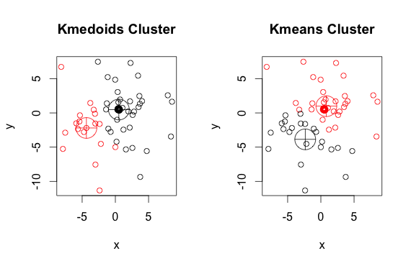
The K-Medoids Clustering Method

Slide 35
The K-Medoids Clustering Method
Find representative objects, called medoids, in clusters.
PAM (Partitioning Around Medoids, 1987)
starts from an initial set of medoids and iteratively replaces one of the medoids by one of the non-medoids if it improves the total distance of the resulting clustering
PAM works effectively for small data sets, but does not scale well for large data sets

Slide 36
EM Algorithm
Initialize K cluster centers
Iterate between two steps
Expectation step: assign points to clusters
Maximization step: estimate model parameters

Slide 37
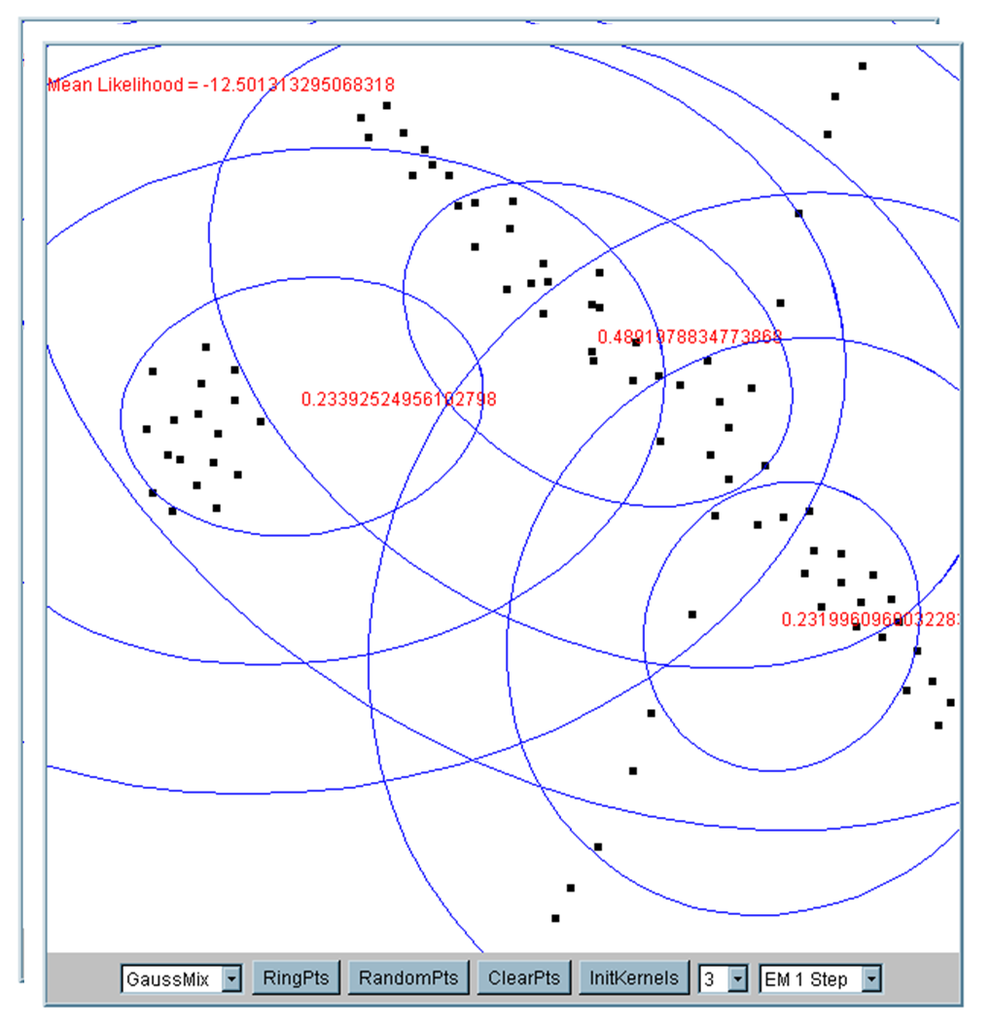
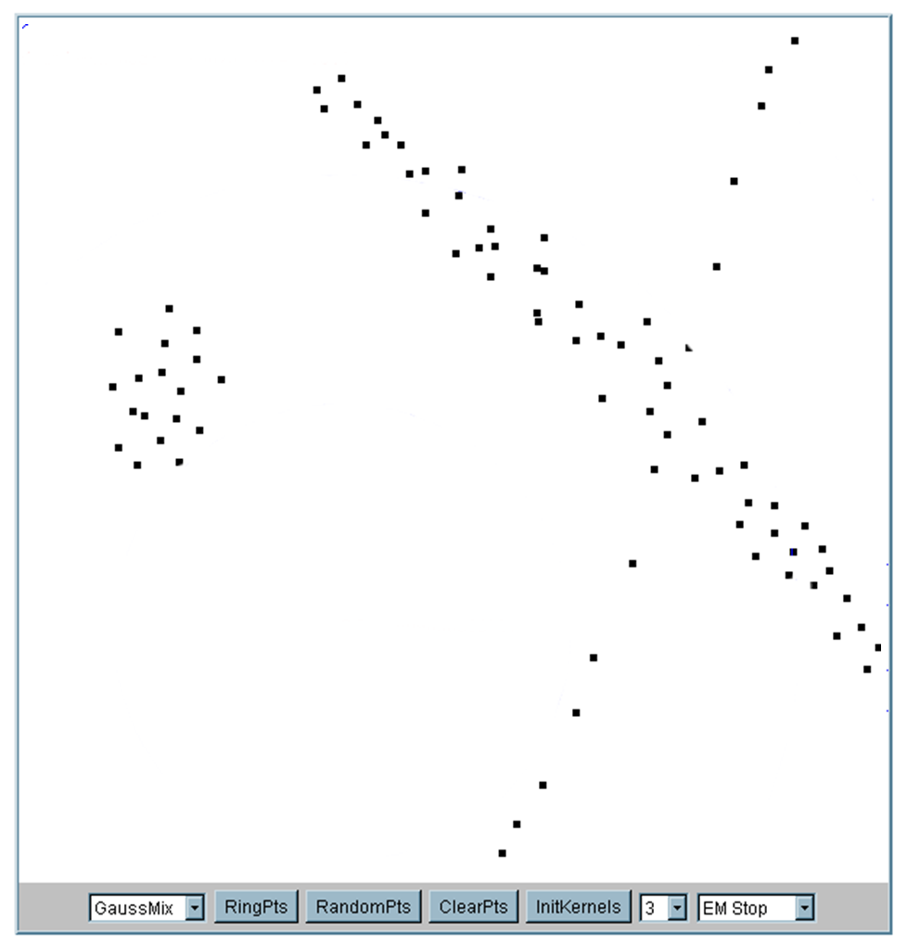
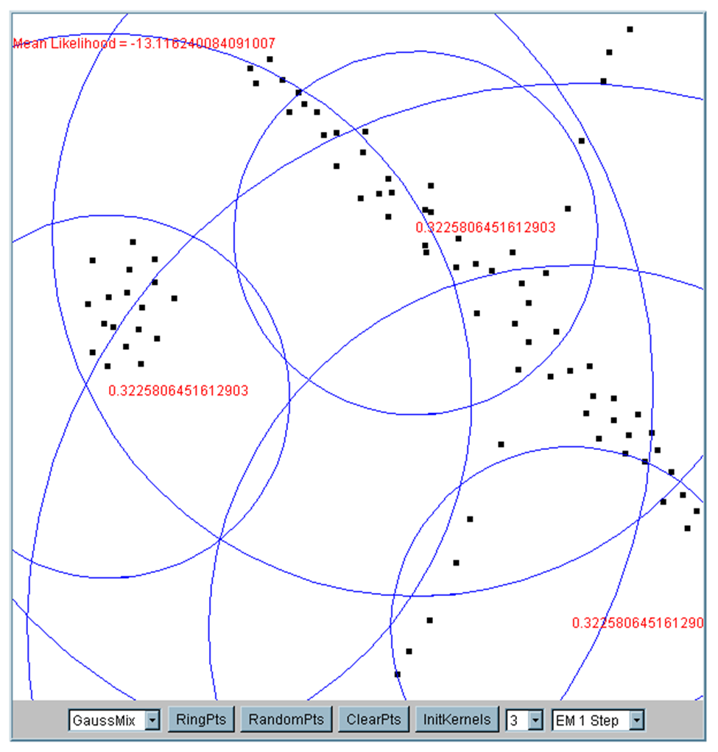
EM Algorithm
Iteration 1
cluster means are randomly assigned
Iteration 2
cluster means are randomly assigned

Slide 38
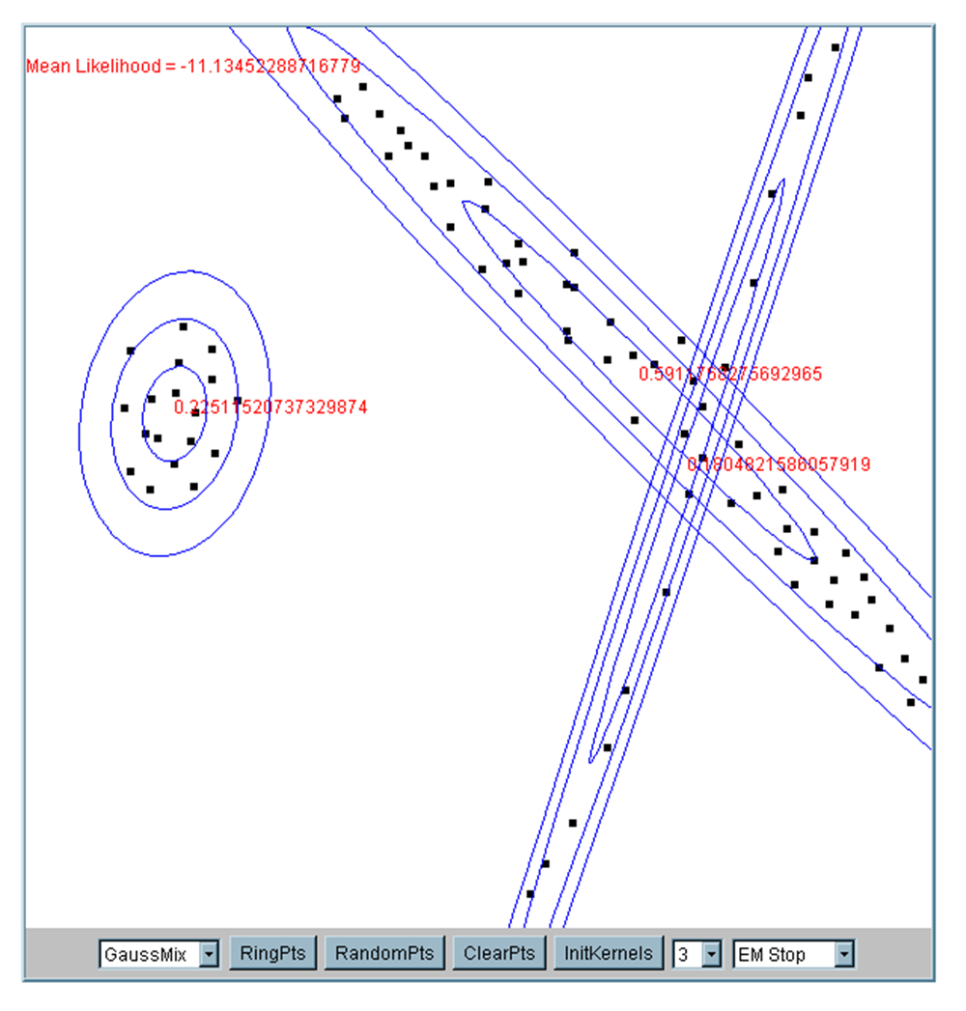
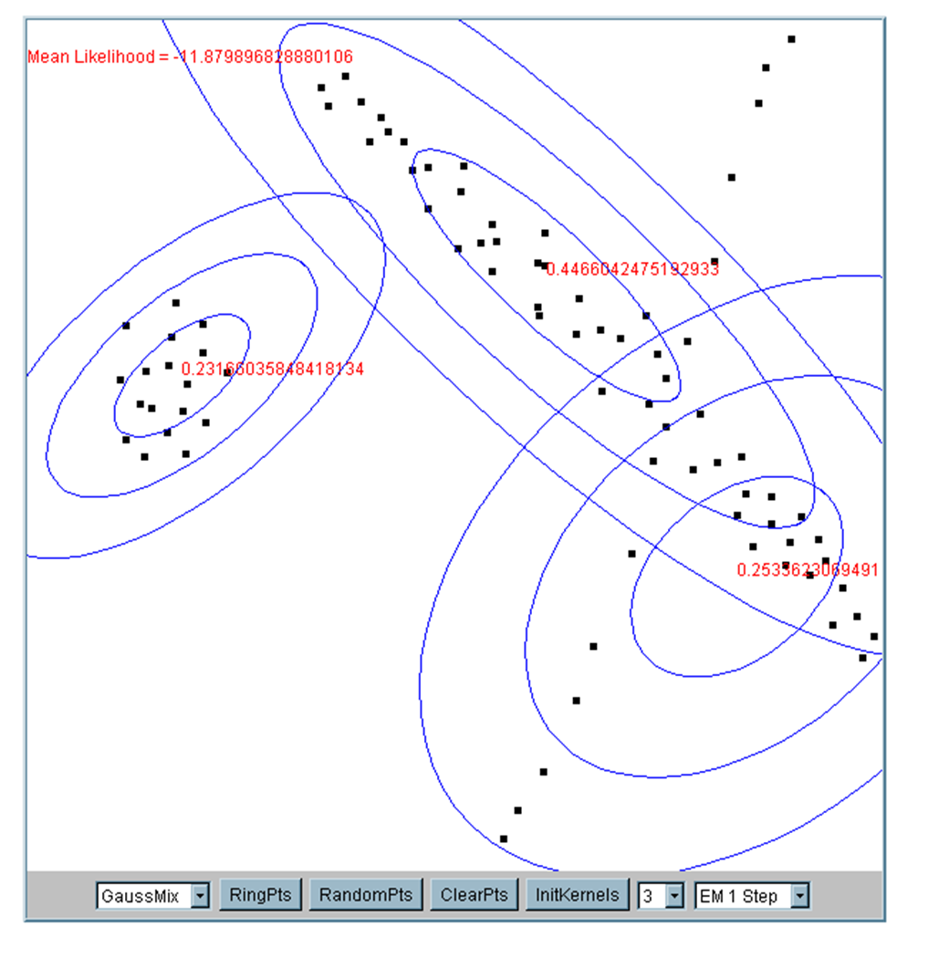
EM Algorithm
Iteration 5
Iteration 25

Slide 39
What happens when data is streaming…

Slide 40
Nearest Neighbor Clustering Not to be confused with Nearest Neighbor Classification
Items are iteratively merged into the existing clusters that are closest
Incremental
Threshold, t, used to determine if items are added to existing clusters or a new cluster is created.

Slide 41
Nearest Neighbor Clustering
10
9
8
7
Threshold t
6
5
4
3
1
t
2
1
2
1
2
3
4
5
6
7
8
9
10

Slide 42
Nearest Neighbor Clustering
10
9
8
7
6
New data point arrives…
It is within the threshold for cluster 1, so add it to the cluster, and update cluster center.
5
4
3
1
3
2
1
2
1
2
3
4
5
6
7
8
9
10

Slide 43
Nearest Neighbor Clustering
New data point arrives…
It is not within the threshold for cluster 1, so create a new cluster, and so on..
10
4
9
8
7
6
5
4
Algorithm is highly order dependent…
It is difficult to determine t in advance…
3
1
3
2
1
2
1
2
3
4
5
6
7
8
9
10

Slide 44
Partial Clustering Algorithms
We need to specify the number of clusters in advance, I have chosen 2
The Birch algorithm
R10
R11
R10 R11 R12
R1 R2 R3
R4 R5 R6
R7 R8 R9
Data nodes containing points
R12

Slide 45
Partial Clustering Algorithms
The Birch algorithm
R10
R11
R10 R11 R12
{R1,R2} R3
R4 R5 R6
R7 R8 R9
Data nodes containing points
R12

Slide 46
Partial Clustering Algorithms
The Birch algorithm
R10
R11
R12

Slide 47
How can we tell the right number of clusters?

Slide 48
How can we tell the right number of clusters?
In general, this is a unsolved problem. However there are many approximate methods. In the next few slides we will see an example.

Slide 49
Right number of K
10
9
For our example, we will use a dataset with 2 classes - class A /class B
However, in this case we are imagining that we do NOT know the class labels. We are only clustering on the X and Y axis values.
8
7
6
5
4
3
2
1
1
2
3
4
5
6
7
8
9
10

Slide 50
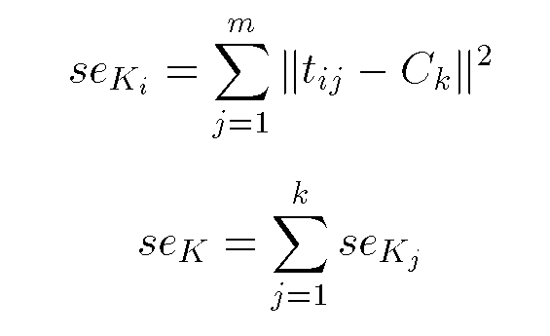
Objective Function
10
9
8
7
6
5
4
3
2
1
Squared Error: Objective Function
1
2
3
4
5
6
7
8
9
10

Slide 51
Right number of K
When k = 1, the objective function is 873.0
1
2
3
4
5
6
7
8
9
10

Slide 52
Right number of K
When k = 2, the objective function is 173.1
1
2
3
4
5
6
7
8
9
10

Slide 53
Right number of K
When k = 3, the objective function is 133.6
1
2
3
4
5
6
7
8
9
10

Slide 54
Right number of K
We can plot the objective function values for k equals 1 to 6…
The abrupt change at k = 2, is highly suggestive of two clusters in the data. This technique for determining the number of clusters is known as “knee finding” or “elbow finding”.
1.00E+03
9.00E+02
8.00E+02
7.00E+02
6.00E+02
Objective Function
5.00E+02
4.00E+02
3.00E+02
2.00E+02
1.00E+02
0.00E+00
k
1
2
3
4
5
6
Note that the results are not always as clear cut as in this toy example

Slide 55
Coding Exercise

Slide 56
Attributions
Some of these slides are based on material on towardsdatascience, David Sontag (who in turn had slides adapted from Luke Zettlemoyer, Vibhav Gogate, Carlos Guestrin, Andrew Moore, Dan Klein). Some material is from Hands-On machine learning ed. 2.
Coding exercise is from Kaggle.com

Slide 57
Open Floor

